Slide 1

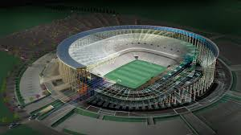
AutoCAD in use
Brief history, Application, Variants and Versions,
Marto Vesheff
SoftUni student
Software University
http://vesheff.com

Slide 2

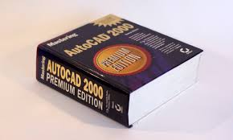
Table of Contents
Brief history of Autodesk
AutoCAD purpose and application
Variants and Versions and BIM
Why I love AutoCAD
Live Demo

Slide 3

Autodesk Brief History

Slide 4
Who is Autodesk?
Autodesk, Inc. is an American multinational software corporation that makes software for the architecture, engineering, construction, manufacturing, media, and entertainment industries.
Founded in 1982 in Mill Valley, California
Founders John Walker, Dan Drake
First and most well known product is AutoCAD

Slide 5
Who is Autodesk?
In 1986 AutoCAD includes AutoLISP, a built-in Lisp programming language interpreter initially based on XLISP. This allows third party developers to extend AutoCAD functionality.
There are many movies which visual effects were created with Autodesk media and entertainment software. Some of the most famous are: X-Men, Planet of the Apes, The Matrix Reloaded, Sin City, Avatar etc.

Slide 6

AutoCAD

Slide 7
AutoCAD Application
AutoCAD is a commercial software application for 2D and 3D computer aided design (CAD).
AutoCAD is the commercial standard for high-end 2D drafting software.
It includes a various 3D functions and since few years it has become very powerful and easy to use.
Most widely used CAD software worldwide.
Civil, mechanical, electrical engineering and architecture.

Slide 8
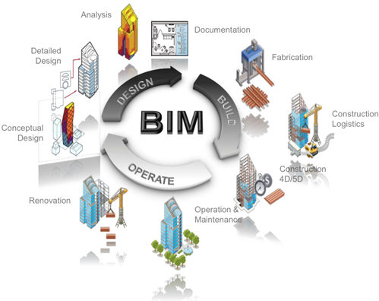
AutoCAD variants and versions and BIM

Slide 9
There are Variants of AutoCAD
There are many versions of AutoCAD.
AutoCAD
AutoCAD Architecture
AutoCAD Civil 3D
AutoCAD Electrical
,AutoCAD Structural Detailing
And many more…

Slide 10
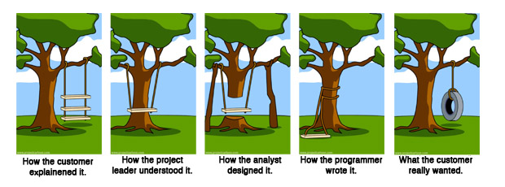
And then there is BIM
BIM stands for Building Information Modeling
BIM is an intelligent model-based process that provides insight to help you plan, design, construct, and manage buildings and infrastructure.

Slide 11
And than there is BIM
There are three dimensions in which we usually represent any engineering project.
Width
Height
Depth
BIM extends them to 5. Yes 5!
4th dimension is time
5th dimension is cost.

Slide 12


Why I love AutoCAD

Slide 13

Keep Calm and Love AutoCAD
The very reasons I personally love AutoCAD.
Highly customisable
Very intuitive UI
Allows the user to create custom commands
and toolbars
You can create your own LISP files and use them in everyday drawing
With a little imagination and creativity everything is possible.

Slide 14

AutoCAD in use
Live Demo

Slide 15
AutoCAD in use
http://vesheff.com

Slide 16
License
This course (slides, examples, demos, videos, homework, etc.) is licensed under the "Creative Commons Attribution-NonCommercial-ShareAlike 4.0 International" license

